Slide 1

Presented By:
Anil Kumar Potnuru
Airlines Data Analysis

Slide 2
About me
Hello, my name is Anil Kumar Potnuru. I have completed my Bachelor’s degree in Computer Science and Engineering, from Gayatri vidya parishad college. I also have hands-on experience as a Full Stack Developer Intern, where I gained practical knowledge of web development.
Why Data Analytics?
Honestly, I wasn’t much interested in traditional IT or coding side of computer science, but I’ve always loved working with data. Especially when I saw how data is used in real-time like in cricket and other sports create real-time insights inspired me to pursue Data Analytics as a career path.

Slide 3
Business Problem
Airline companies deal with huge amounts of flight data — prices, routes, stops, departure times, duration, airlines, etc.
The main goal is understand what factors affect ticket prices and understand pricing patterns.

Slide 4
Airline Dataset Analysis
Airlines are one of the most widely used modes of transportation, connecting people across cities and countries efficiently
The dataset helps us to know the price trends of airlines over the time.
The dataset contains 306156 rows and 11 columns.
It includes 3 numerical columns and 8 categorical columns.
This dataset provides flight-related details such as airline name, source and destination cities, departure and arrival times, number of stops, travel class, flight duration, days left before departure, and ticket price.
Some columns contain missing values like (airline, price, duration) that need to be handled using appropriate method.
Since the dataset contains duplicate values, they need to be dropped to ensure data accuracy.

Slide 5
Understanding the Columns
S.No | Column Name | Missing Values | Data Type | Data Quality Issues | Cleaning/Preprocessing Required | Importance
1 | Airline | 6004 | Categorical | No | Yes(Mode fill) | Name of the airline operating the flight (e.g., indigo)
2 | Flight | 0 | Categorical | No | No | Unique flight number or code assigned by the airline.
3 | Source_city | 0 | Categorical | No | No | The city from which the flight departs.
4 | Departure_time | 0 | Categorical | No | No | Scheduled time of flight departure (e.g., Morning, Evening, Night)
5 | Stops | 0 | Categorical | No | No | Number of stops or layovers in the journey (e.g., Non-stop, 1 Stop, 2 Stops).
6 | Arrival_time | 0 | Categorical | No | No | Scheduled time of arrival at the destination (e.g., Morning, Night)
7 | Destination_city | ~5 | Categorical | No | No) | The city where the flight arrives
8 | Class | 0 | Categorical | No | No | Travel class booked by the passenger (e.g., Economy, Business)
9 | Duration | 6004 | Numerical | No | Yes(Median fill) | Total duration of the flight (in hours and minutes)
10 | Days_left | 0 | Numerical | No | No | Number of days left before the date of departure.
11 | Price | 6004 | Numerical | No | Yes(Median fill) | PTicket price for the given flight (target variable for price prediction/analysis)

Slide 6
Handling Missing Data
Missing data may occur due to human error, recording, transfer error, system failure etc. May lead to inappropriate analysis.
To check null values: df.isnull().sum() gives no.of missing values in each column.
Columns with missing values: airline (6004), duration (6004), price (6004).
To handle missing data there are some methods like imputation and drop.
Drop if the missing data is very small(<5%) or huge(>70%).
Imputation for numerical columns(median) and categorical column(mode).
Handling Duplicates:
Duplicates are repeated records in the dataset that can inflate counts and bias analysis.
Checked for duplicates in dataset and found 6003 and removed using df.drop_duplicates() method.
Ensures dataset remains clean without redundancy.

Slide 7
Handling Outliers
Outliers are data points that are different or far away from other values that don’t follow general pattern.
  In Airline dataset outliers occur in price and duration columns.
  They may arise due to human error, system glitches, or may be festival season particularly in this dataset.
  Detecting and understanding outliers is important because they can affect the accuracy of analysis and model performance.
  They are detected using IQR technique and boxplot.
  The lower and upper limits were calculated, and records outside these limits were treated.
  Handling outliers improved data quality, accuracy of insights, and visual clarity in analysis.

Slide 8
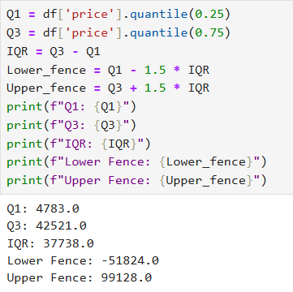
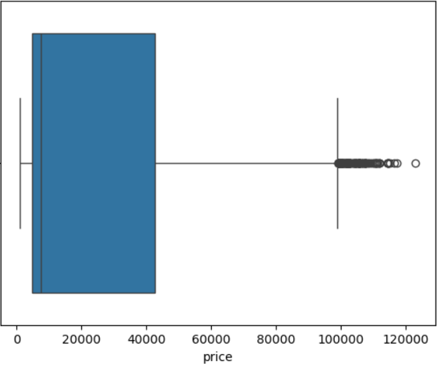
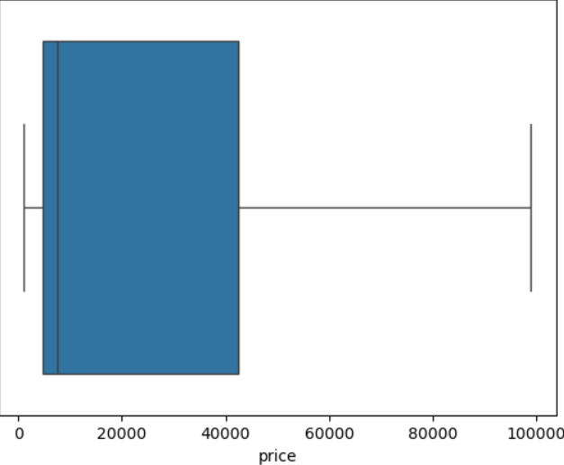
Before Removing
Visual Representation Of Outliers
  Calculated the Lower fence and Upper fence with IQR.
  Values beyond and above the fence are outliers.
  You can see before and after filtering outliers images.
After Removing

Slide 9
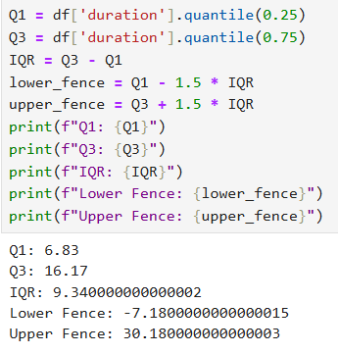
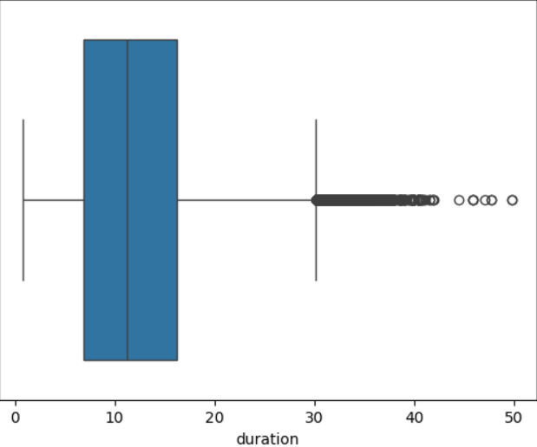
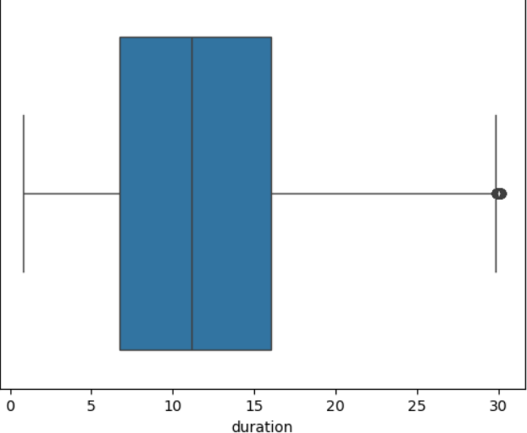
In duration column
  Calculated the Lower fence and Upper fence with IQR.
  Values beyond and above the fence are outliers.
  But you can still see some outliers too after filtering, because those are near to edge or borderline values.
Before Removing
After Removing

Slide 10
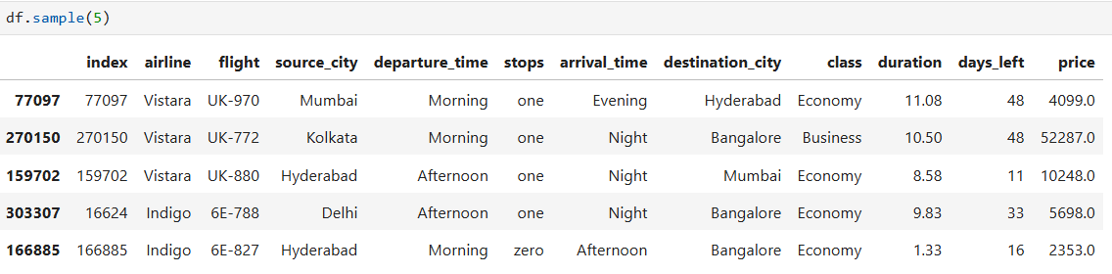
Target Variable
yes- there is a target variable in my dataset and i.e Price column.
It is dependent column based on the other columns the Price column will change.
We can predict the fare of flight based on other columns.

Slide 11
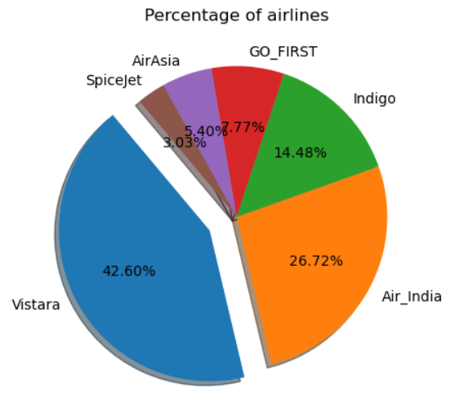
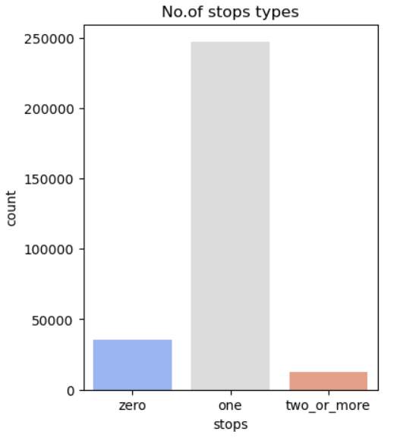
Univariate Analysis
Univariate analysis examines a single variable at a time to understand its distribution and frequency.
Shows which airline appear most frequently in the dataset.
No. of flights connecting through each stop.

Slide 12
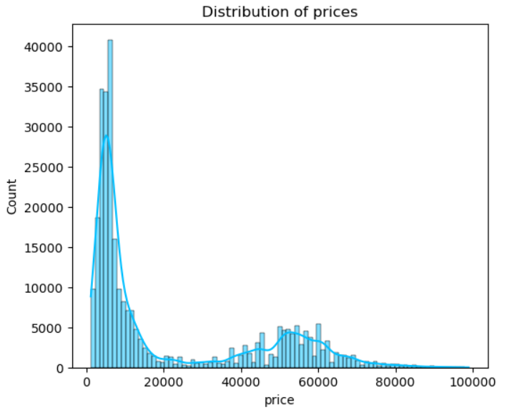
Distribution of flight prices
Most flight price are between range 1000- 15000 with budget-friendly and affordable.
There are very few flights between 20,000-40,000.
As we can see there are some more flights between 40,000 to around 65,000 maybe business class tickets.
Very less no. of flights having the cost cut above 85,000 maybe they are non-stop flights with business class.

Slide 13
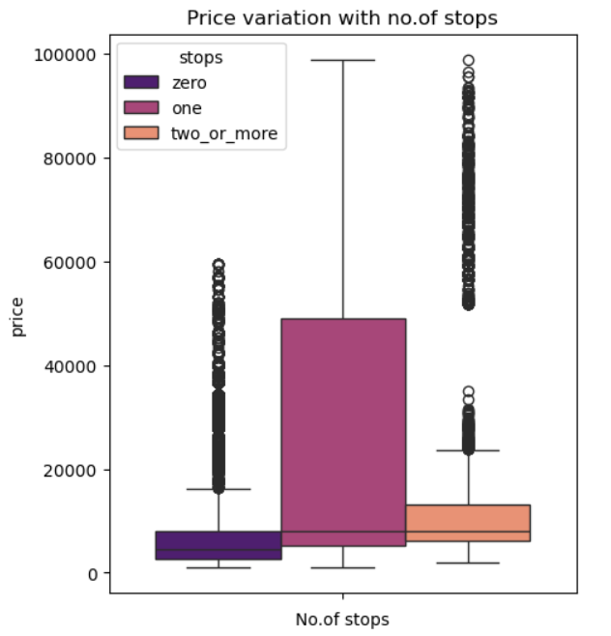
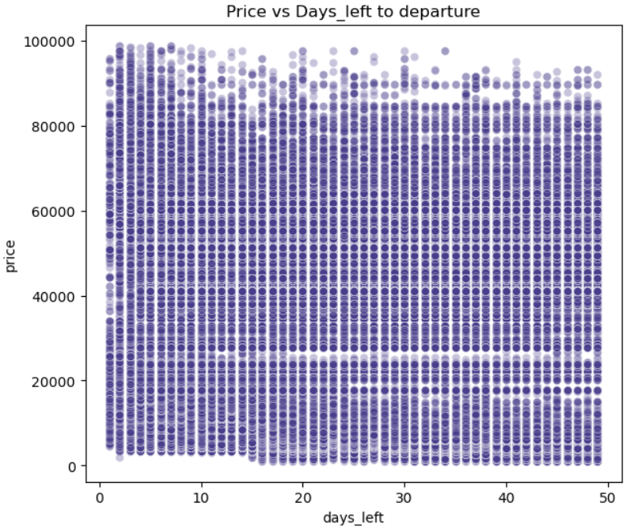
Bivariate Analysis
Bivariate analysis examines the relationship between two variables are they correlated, dependent, or independent.
Price variation between price and no.of stops and price and days_left.

Slide 14
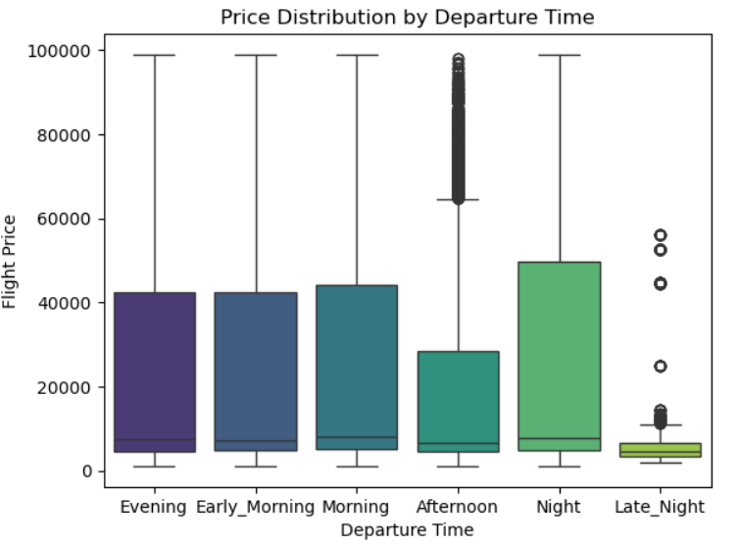
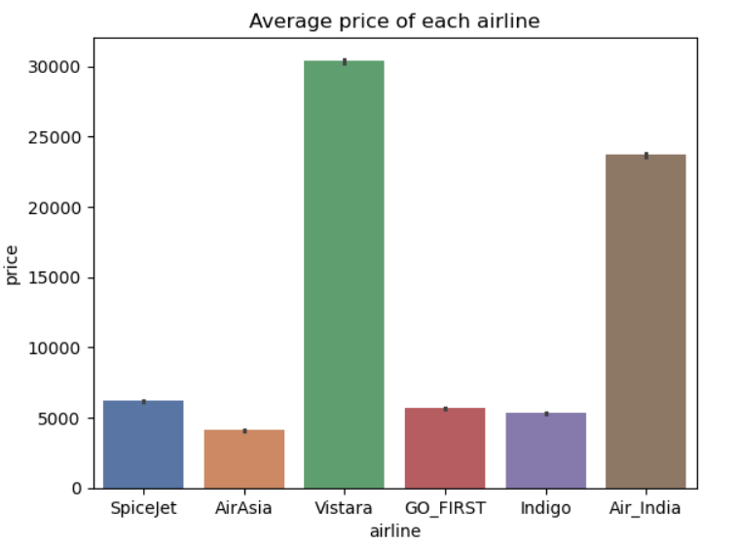
Outliers represent flight prices that are significantly higher than the rest. These could be due to last-minute bookings, premium airlines, business class seats, or limited availability on popular routes.
The boxplot shows that flight prices vary with departure time. Late-night flights are generally cheaper, while morning and evening flights tend to be more expensive. The outliers represent high-priced tickets due to premium services or peak-time demand.
As we can see here AirAsia having the avg ticket price among the other airlines below 5k.
So the AirAsia airlines is the cheapest airline with budget friendly and affordable ticket prices to travel.

Slide 15
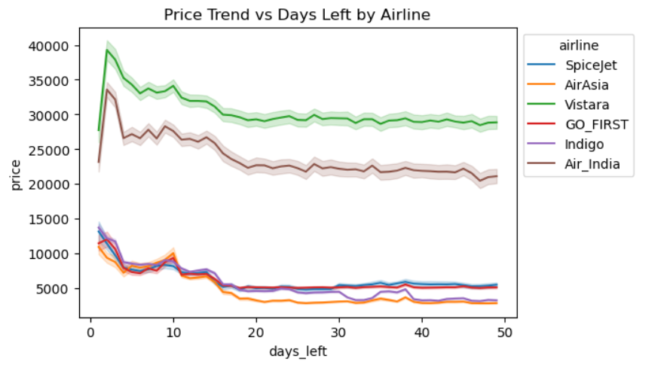
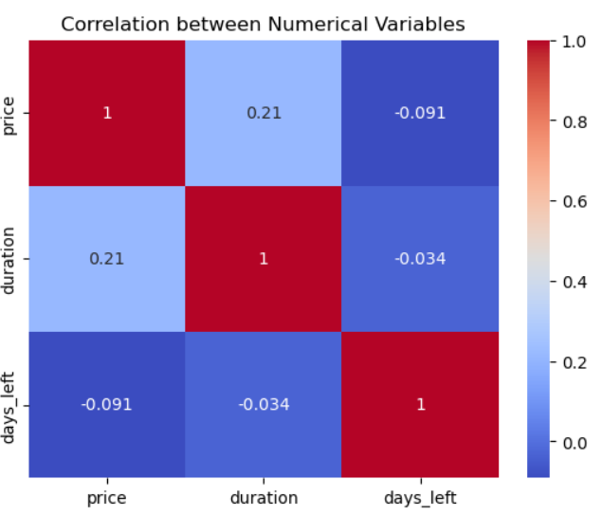
Multivariate Analysis
Multivariate analysis explores relationships among three or more variables simultaneously.
Lineplot and Heatmap to see the numeric changes over time for price trends and correlation between the columns.
Price trend by airline and days_left and relation b/w price, duration, days_left.

Slide 16
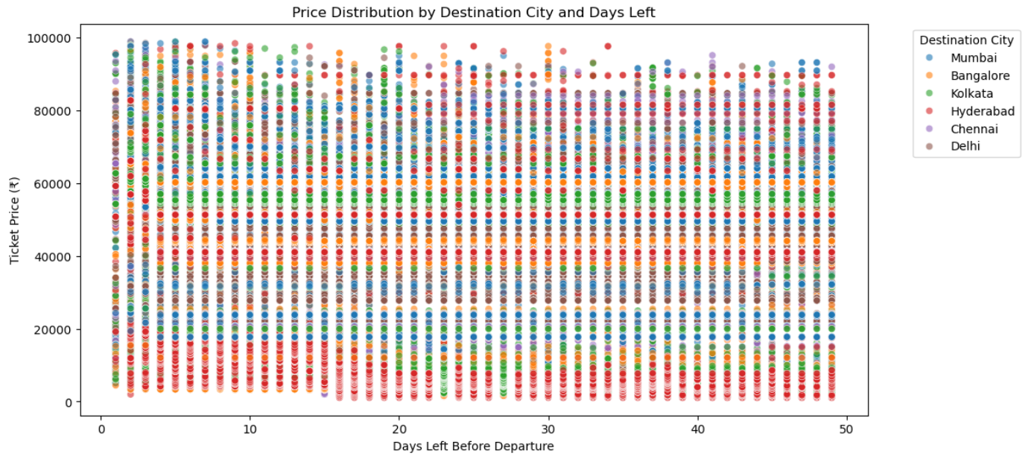
As we can see here there is change of ticket price as the days_left are decreasing.
But according to the destination city the price variation takes place and this is called dynamic pricing.

Slide 17
Key Insights
Vistara operates the most flights and has the highest average ticket prices, while AirAsia offers the lowest-priced fares.
Zero-stop flights are generally cheaper, but one-stop flights often cover premium or long routes.
Morning and evening flights are priced higher due to peak demand.
Economy class dominates bookings, with over two-thirds of passengers choosing it.
Found a weak negative correlation between days_left and price, meaning early bookings slightly reduce costs.
AirAsia is one of the budget friendly operating airline with fare prices to travel.
Because most of the AirAsia flights are arriving at Late_night to take the advantage of cheaper airport slot and are called Red-Eye Flights.
Vistara takes the most of the Early_morning flight for fast filling due to cheap airport slots.

Slide 18
Conclusion
This dataset provides the analysis and explain how price strategies in aviation industry.
We can see pricing and scheduling are not random, it’s a move by the airlines.
If passengers want low price flights they have to sacrifice sleep and comfort.
This dataset only provides about the domestic(with in india),if we have the international routes we can see the price variation for the international connections too.
Overall, ticket price trends depend on multiple factors such as number of stops, airline, and booking timing — not just distance alone.

Slide 19

THANK YOU

